Slide 1
Technologies du Web Sémantique
Claudine Métral
Gilles Falquet

Slide 2
Introduction to the Semantic Web
G. Falquet
Semantic Web Technologies

Slide 3
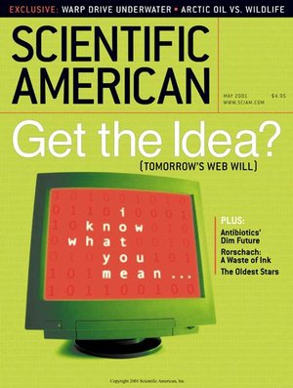
Main ideas (2001)
A web
readable/understandable by software agents
pages on the web would be meaningful to programs
encompassing not just documents but every kind of data one could imagine
interconnecting data (stored in different servers)

Slide 4
A use case: organizing Mom's therapy
[…]At the doctor’s office, Lucy instructed her Semantic Web agent through her handheld Web browser. The agent promptly retrieved the information about Mom’s prescribed treatment within a 20-mile radius of her home and with a rating of excellent or very good on trusted rating services. It then began trying to find a match between available appointment times (supplied by the agents of individual providers through their Web sites) and Pete’s and Lucy’s busy schedules.
Berners-Lee, Tim, James Hendler, and Ora Lassila. “The Semantic Web.” Scientific American, May 2001,

Slide 5
Required technologies
knowledge representation
formally represent the information/knowledge content of a web site
data representation
data representation framework for semi-structured data
interconnection
global/shared object identification technique (for cross-server links)
shared ‘vocabularies’ and concept description
reasoning/computing services
logical inferences; computation (spatial, temporal, …); decision making; ...
decentralized web services

Slide 6
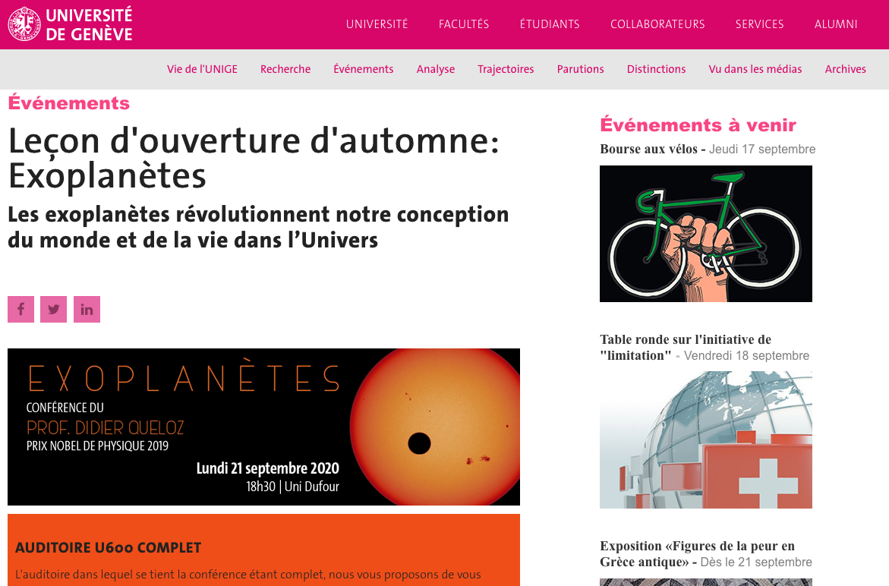
Knowledge representation
a typical web page

Slide 7
Human understanding
event descriptions
event place
presenter
presenter's attribute
special announcement

Slide 8
Machine understanding
text text text text text text
text text text text
text text text text
text text text
text
text text

Slide 9
a logic-based approach
define a logical language (vocabulary)
represent the page content with logical formulae
represent more general knowledge

Slide 10
the page in Description logic
Event(c1)
Conference(c1)
title(c1, "Exoplanètes …”)
speaker(c1, dq)
...
Person(dq)
name(dq, "Didier Queloz")
...
Event(bav)
title(bav, "Bourse aux vélos")

Slide 11
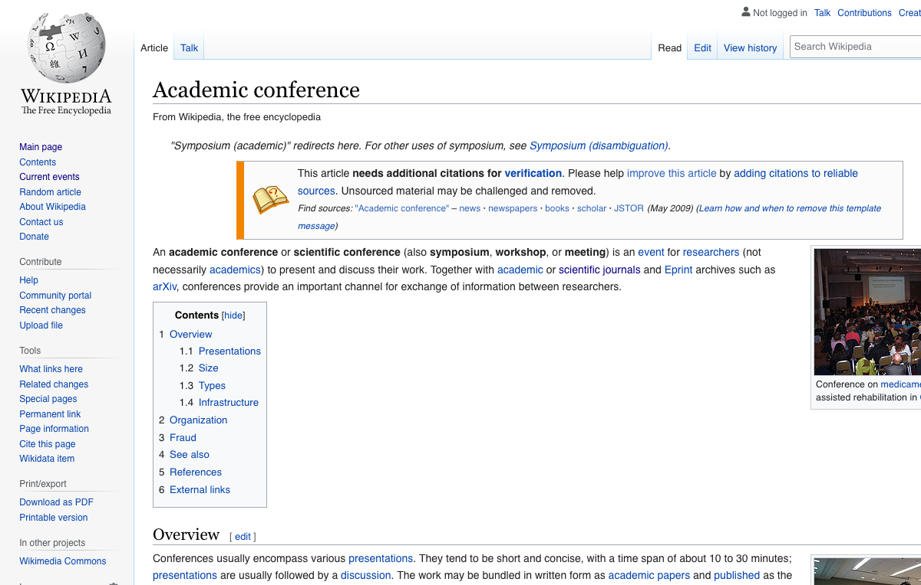
Requires some background knowledge. What is a conference?

Slide 12
formalized in description logics
Conference
subclass-of Event
subclass-of ∃ title . String
subclass-of ≥₁ speaker . Person
Person
subclass-of HumanBeing
subclass-of ∃ birthPlace . Place
subclass-of ∀ employer . (Organization or Person)

Slide 13
Data representation
multiple data models
relational databases, spreadsheets, graphs, …
different levels of structure
text → unstructured
…
database → fully structured

Slide 14
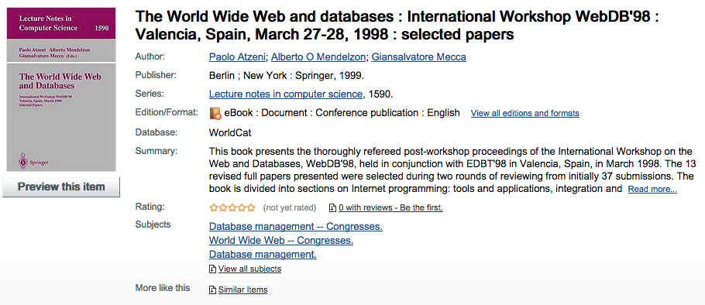
not a new problem

Slide 15
Semi-structured Data
“Roughly speaking, semi-structured data is data that is neither raw data nor very strictly typed as in conventional database systems” (Abiteboul 1997)
Exemples
Web pages about restaurants
BibTeX files
...
Serge Abiteboul, “Querying Semi-structured data,” in International Conference on Data Base Theory (ICDT), pp. 1 – 18, Delphi, Greece, 1997. http://dbpubs.stanford.edu:8090/pub/1996-19.

Slide 16
A BibTeX file
@article{miller1995wordnet,
Author = {Miller, George A},
Journal = {Communications of the ACM},
Number = {11},
Pages = {39--41},
Publisher = {ACM},
Title = {WordNet: a lexical database for English},
Volume = {38},
Year = {1995}}
@techreport{masolo2003wonderweb,
Author = {Masolo, Claudio and Borgo, Stefano and Gangemi, Aldo and Guarino, Nicola and Oltramari, Alessandro},
Institution = {LOA-ISTC-CNR},
Title = {The WonderWeb library of foundational ontologies and the DOLCE ontology. WonderWeb (EU IST project 2001-33052) deliverable D18},
Year = {2003}}
@inproceedings{niles2001towards,
Author = {Niles, Ian and Pease, Adam},
Booktitle = {Proceedings of the international conference on Formal Ontology in Information Systems-Volume 2001},
Organization = {ACM},
Pages = {2--9},
Title = {Towards a standard upper ontology},
Year = {2001}}

Slide 17
Main aspects
Irregular structure
heterogeneous, incomplete elements
Implicit structure
structure in textual parts => parsing
Partial structure
unstructured parts: plain text, images, external data
Indicative structure vs. constraining structure
schema adds information

Slide 18
Main aspects
A-posteriori schema/data guide
created to structure existing data (from the data)
Large schema
e.g. wikidata
Schema ignored
in discovery/navigation queries the schema must be ignored
Rapidly evolving schema
e.g. in scientific databases (new techniques/knowledge)

Slide 19
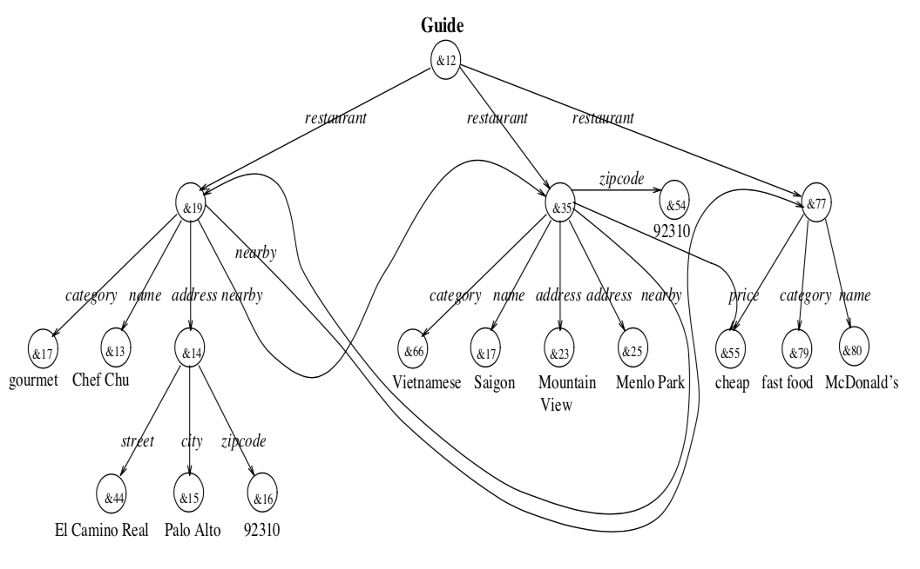

Slide 20
in JSON
[ {"type": "public-conference", "title": "Exoplanètes …", …},
{"type": "exhibition", "title": " …", ",
time-period: {"from": "…", "to": …"d}, …
},
…
]

Slide 21
“Standard” Solutions
old style: XML
+ XML Schema, XSL transformations, XML APIs
new style: JSON
+ JSON APIs, JSON Schemas

Slide 22
Interconnection
Problem: different databases use different identifiers for the same entity
Company | Headquarters | ...
IBM | Unites States
Telefónica | Spain
Orange | France
Part | Origin | ...
Motor | DE
Windows | FR
Wheels | USA
Database 2
Database 1

Slide 23
The Semantic Web isn’t just about putting data on the Web. It is about making links, so that a person or machine can explore the Web of Data.
With Linked Data, when you have some of it, you can find other, related, data.
Tim Berners-Lee

Slide 24
The Linked-data Solution
Use URIs as names for things.
Use HTTP URIs so people can look up those names.
When someone looks up a URI, provide useful information using the standards.
Include links to other things, so people can discover more.

Slide 25
A resource is the main information building block
Anything that can be named is a resource.
Information resources entities that convey information and can be completely represented in binary code:
documents, images, video, software …
Non-information resources cannot be represented as bits:
people, phenomena, concepts, ideas …

Slide 26
Web resources are conceptual relations uniquely identified by HTTP URLs
An HTTP URL points to at most one resource.
If it is an information resource, HTTP allows clients to retrieve a representation of it.
The concept pointed to by an URL shouldn’t change.
The value and representations retrieved when looking up an URL might change over time.

Slide 27
Using HTTP URIs ensures that anybody can look up the resource
An HTTP URI of a resource can be dereferenced:
use an HTTP client to retrieve a representation.
Information resources result in a representation.
Non-information resources result in a 303 redirect.
Relies on the double role of an HTTP URI as identifier and locator.
Principle: If you don’t know something, look it up. Follow your nose.

Slide 28
Dereferencing a URI should lead to useful information about that resource
“Useful” means the information is available using standard technologies.
(RDF and SPARQL)
“Useful” also means the information provides explanations and/or context for the resource
Define the resource in terms of concepts the client already knows or can look up.

Slide 29
By including links to other resources, we create a Web of Data
Links connect a resource to known concepts.
Alberto is a researcher at U. of Toronto
Links give meaning to data.
These temperatures are measured in degrees Celsius.
Links allow exploration of related data.
Find more by the same author.

Slide 30
Basic information unit: the link
Paramaribo
A link connects two resources
Suriname

Slide 31
The resources are identified by URIs
http://dbpedia.org/resource/Paramaribo
http://dbpedia.org/resource/Suriname

Slide 32
Using prefixes to abbreviate the URIs
dbr = http://dbpedia.org/resource/
dbr:Paramaribo
dbr:Suriname

Slide 33
The links are typed (unlike Web links)
dbr:Paramaribo
dbo:capital
The link type is also identified by a URI
dbr:Suriname

Slide 34
... so the link type can be described
dbo:PopulatedPlace
dbr:Paramaribo
dbo:capital
rdfs:domain
dbo:capital
rdf:type
rdfs:range
dbr:Suriname
rdf:Property
dbo:City
dbr = http://dbpedia.org/resource/
dbo = http://dbpedia.org/ontology/
rdf = http://www.w3.org/1999/02/22-rdf-syntax-ns#
rdfs = http://www.w3.org/2000/01/rdf-schema#

Slide 35
Links can point to typed literal values
dbr:Paramaribo
dbp:establishedDate
dbo:capital
1603
dbr:Suriname

Slide 36
Creating a web of data
dbr:Saw_Teong_Hin
dbo:director
dbr:Paramaribo
dbr:Puteri_Gunung_Ledang_(film)
dbp:establishedDate
dbo:capital
1603
dbo:language
dbr:Suriname
dbo:language
dbo:language
dbr:Javanese_language
dbr:Carribean_hindustani

Slide 37
In a machine readable form
@prefix dbr: <http://dbpedia.org/resource/>
@prefix dbo: <http://dbpedia.org/ontology/>
@prefix rdf: <http://www.w3.org/1999/02/22-rdf-syntax-ns#>
@prefix rdfs: <http://www.w3.org/2000/01/rdf-schema#>
dbr:Suriname dbo:language dbr:Carribean_hindustani.
dbr:Suriname dbo:language dbr:Javanese_language.
dbr:Suriname dbo:capital dbr:Parmaribo.
dbr:Parmaribo dbp:establishedDate 1603.
dbr:Puteri_Gunung_Ledang_(film) dbo:dirctor dbr:Saw_Teons_Hin.
dbr:Puteri_Gunung_Ledang_(film) dbo:language dbr:Javanese_language.

Slide 38
Compared to relational databases
No constraining database schema
DB: putting data in predefined boxes (tables, rows, columns)
SW: linking data
Open world
DB: what is not in the database is true, what is absent is false, (closed world)
SW: what is described is true, what is absent is unknown
but we may have negative descriptions
Global vocabulary (identifiers)
the resource and property names (URIs) are globally visible

Slide 39
RDF
https://rubenverborgh.github.io/WebFundamentals/semantic-web/#rdf-model

Slide 40
Interconnection
Problem: the same term may have different meaning in different databases
Ontology solution: Create shared concept descriptions
schema.org, Linked open vocabularies, …
use common concept description languages (RDFS, OWL, …)

Slide 41
Reasoning
Make logical inferences
find the logical consequences of facts and rules
test the consistency of a set of logical formulae

Slide 42
State of the SW
the Semantic Web does not exist
not as imagined by TBL et al.
big companies have created their SW (e.g. Apple Siri, Google services, …)
Many SW technologies are operational
Resource description framework, Ontology languages
Querying and reasoning software
Semi-structured databases (RDF triple stores, graph databases, …)
Knowledge graphs

Slide 43
Content of the course
resource description with RDF graphs
linked data
ontologies and logical reasoning for description logic and logic programming
representing time and space
interoperability
knowledge graphs

